Slide 1


Enhancing Security of Data using Image Steganography and Encryption
Bangalore Institute of Technology
K.R. Road, V V Puram, Bangalore-560004
Department of Electronics and Communication Engineering
MINI-PROJECT PRESENTATION
Under the guidance of:
Co-evaluator:
Presented by
Mrs. Bhavya K B
Assistant Professor
Dept. of ECE
BIT.
Dr. Kalpana A B
Professor
Dept. of ECE
BIT.
Shashidhara -1BI20EC131
Soujanya S -1BI20EC147
Varsha V -1BI20EC169
Vivek D -1BI20EC174

Slide 2
INSTITUTE VISION AND MISSION
Vision: To establish and develop the Institute as the centre of higher learning, ever abreast with expanding horizon of knowledge in the ﬁeld of Engineering and Technology with entrepreneurial thinking, leadership excellence for life-long success and solve societal problems.
Mission:
1: Provide high quality education in the Engineering disciplines from the undergraduate through doctoral levels with creative academic and professional programs.
2: Develop the Institute as a leader in Science, Engineering, Technology, Management and Research and apply knowledge for the beneﬁt of society.
3: Establish mutual beneﬁcial partnerships with Industry, Alumni, Local, State and Central Governments by Public Service Assistance and Collaborative Research.
4: Inculcate personality development through sports, cultural and extracurricular activities and engage in the social, economic and professional challenges
Bangalore Institute of Technology
Dept. of ECE, BIT

Slide 3
DEPARTMENT VISION , MISSION, PEOs, PSOs
Vision:
Imparting Quality Education to achieve Academic Excellence in Electronics and Communication Engineering for Global Competent Engineers.
Mission:
• Create state of art infrastructure for quality education.
• Nurture innovative concepts and problem solving skills.
• Delivering Professional Engineers to meet the societal needs.
Bangalore Institute of Technology
Dept. of ECE, BIT

Slide 4
Course Outcomes of Mini-Project
1 | Ability to carry-out literature review and define the problem.
2 | Ability to co-ordinate to work as a team member or a single member.
3 | Inculcate methods to use advance tools .
4 | Design analytical modeling and develop a systems
5 | Ability to equip analysis skills and interpretation.
6 | Enhance presentation skills, drafting and documentation of project work.
CO-PO Mapping Table
PO CO | 1 | 2 | 3 | 4 | 5 | 6 | 7 | 8 | 9 | 10 | 11 | 12 | PSO 1 | PSO 2 | PSO 3
1 | 3 | 2 | 2 |  |  | 1 |  | 1 | 1 | 1 |  |  | 2 | 2
2 | 3 | 2 | 2 |  |  | 1 |  | 1 | 1 | 1 |  |  | 2 | 2
3 | 3 | 2 | 2 |  | 3 |  |  | 1 | 1 | 1 |  |  | 2 | 2
4 | 3 | 2 | 2 |  | 3 | 1 |  | 1 | 1 | 1 |  |  | 2 | 2
5 | 3 | 2 | 2 |  | 3 | 1 |  | 1 | 1 | 1 |  |  | 2 | 2
6 | 3 |  |  |  | 3 |  |  | 1 | 1 | 1 | 2 |  | 2 | 2
Bangalore Institute of Technology
Dept. of ECE, BIT

Slide 5
ABSTRACT
We address the problem of enhancing security of a secret image and secret message that is to be sent over a network, by digitally processing it. We require that the secret image and secret message to be sent to the recipient in such a way that no one else suspects the existence of them.
A cover image is used as a decoy in this technique in which the secret image as well as the secret message are embedded.
On the sender’s side, the secret image and the secret text is encrypted and embedded into a cover image, which is further segmented into parts.
On the receiver side, these sub images are fetched one by one and merged based on their index. Decryption is performed to extract the original secret text and secret image from the encrypted secret image.
Bangalore Institute of Technology
Dept. of ECE, BIT

Slide 6
CONTENTS
INTRODUCTION
LITERATURE SURVEY
OBJECTIVES
METHODOLOGY
IMPLEMENTATION AND DESIGN
RESULTS AND OBSERVATIONS
CONCLUSION
FUTURE WORK
REFERENCES
Bangalore Institute of Technology
Dept. of ECE, BIT

Slide 7
INTRODUCTION
In today’s world of growing technology security is of utmost concern, providing only network security is not sufficient. Techniques like steganography, encryption and cryptography can be used to keep our data confidential.
As the text message is encrypted using LSB algorithm and embedded in a part of the image the text message is difficult to find.
Moreover since the secret image is broken down into parts and then sent to the receiver. This makes it difficult for the trespassers to get access to all the parts of the images at once.
Thus increasing the security to a much needed higher level. This makes it becomes highly difficult for the intruder to detect and decode the document.
Bangalore Institute of Technology
Dept. of ECE, BIT

Slide 8
LITERATURE SURVEY
SL NO | TITLE | AUTHOR | METHODOLOGY | PUBLISHED YEAR
1. | 128-bit AES Implementation for Secured Wireless Communication | Masumeh Damrudi, Kamal Jadidy Aval | The paper examines the cryptographic techniques as well as the steganography algorithm LSB. Techniques are verified by implementing in the matlab environment and comparing factors like encryption and decryption time, PSNR, SNR, and MSE. Using the mentioned algorithms, the data is encrypted, followed by the secret message embedded using LSB algorithm. | 2019
Bangalore Institute of Technology
Dept. of ECE, BIT

Slide 9
LITERATURE SURVEY
SL NO. | TITLE | AUTHOR | METHODOLOGY | PUBLISHED YEAR
2. | Hiding data in images using steganography techniques with compression algorithms | Osama F. AbdelWahab, Aziza I. Hussein, Hesham F. A. Hamed, Hamdy M. Kelash, Ashraf A.M. Khalaf and Hanafy M. Ali, | This paper explores on the steganographic techniques along with compression algorithm, embedding and extracting algorithm. LSB algorithm is used with no encryption and compression which is vulnerable to attacks as it can be easily detected. In second technique the secret message is encrypted and LSB is applied with DCT algorithm to transform the image into frequency domain. | 2021
Bangalore Institute of Technology
Dept. of ECE, BIT

Slide 10
OBJECTIVES
To develop secure image steganography technique by combining the AES encryption algorithm and the LSB embedding algorithm, considering factors such as data hiding capacity, image quality preservation, and encryption strength.
To achieve unnoticeable embedding of secret data within the image using the LSB algorithm, minimizing any visible changes to the image.
To enhance the resistance against steganalysis techniques by employing AES encryption, making it difficult for unauthorized parties to detect and extract the hidden information.
Bangalore Institute of Technology
Dept. of ECE, BIT

Slide 11
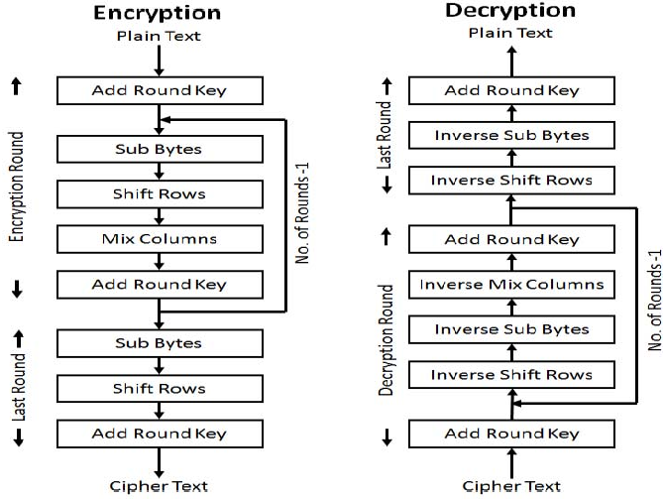
METHODOLOGY
The entire workflow of the proposed system is broken down into four phases. Initially the secret image is broken into multiple parts.
Encryption phase :
In this phase AES algorithm is used to encrypt the secret message.
The AES algorithm uses a round function that is composed of four different byte related transformations:
Sub-Bytes step
Shift Rows step
Mix Columns step
Add Round Key step
Bangalore Institute of Technology
Dept. of ECE, BIT

Slide 12
METHODOLOGY
Embedding phase:
Cipher text is hidden inside the image using LSB based image steganography algorithm.
Hiding phase:
Cover Image is segmented into parts and part of secret image which also contains the
secret text is hidden behind the cover image using LSB technique.
Stitching phase:
The sub images are stitched back to get the original cover image using K-nearest neighbour
supervised algorithm. Apply inverse AES algorithm decryption.
Bangalore Institute of Technology
Dept. of ECE, BIT

Slide 13
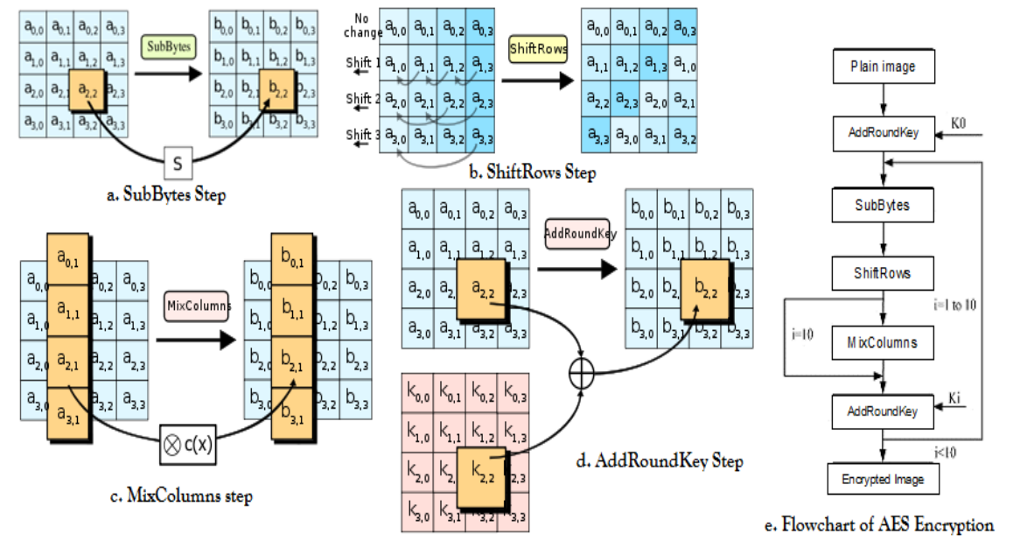
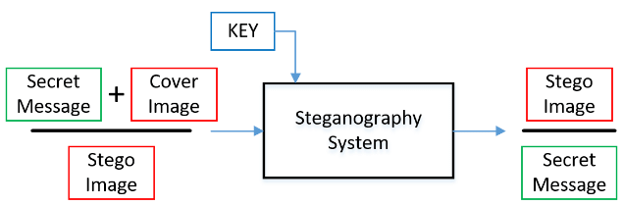
METHODOLOGY
AES ALGORITHM STEPS
LSB image-based steganography
Bangalore Institute of Technology
Dept. of ECE, BIT

Slide 14
IMPLEMENTATION & DESIGN
To implement the proposed system, we are using Matlab R2023a. The implementation involves a series of steps. They are listed as follows:
The given secret image is resized to a known size. The sender and receiver use a key of 128 bits.
The secret image is converted into a cipher image using AES algorithm. This secret image is encrypted.
The secret text is converted into ASCII and binary representation. This is embedded in the encrypted secret image using LSB- based image steganography.
This image with the secret text is embedded in the cover image by again using LSB algorithm.
The embedded cover image is divided into multiple parts (here 16 parts). These are steps done at the sender end.
Bangalore Institute of Technology
Dept. of ECE, BIT

Slide 15
IMPLEMENTATION & DESIGN
At the receiver’s end, the sub-images are stitched back together to regain the embedded cover image by using k-nearest algorithm.
The least significant bits are extracted 8 bits at a time from the merged image to get the entire size of the cipher image.
The secret text from the cipher image is obtained by extracting least significant bits until we hit a number representing zero.
The cipher image is decrypted using AES decryption, i.e., reverse AES encryption is now performed in reverse order.
This produces the required secret image and secret text at the receiver end.
Bangalore Institute of Technology
Dept. of ECE, BIT

Slide 16
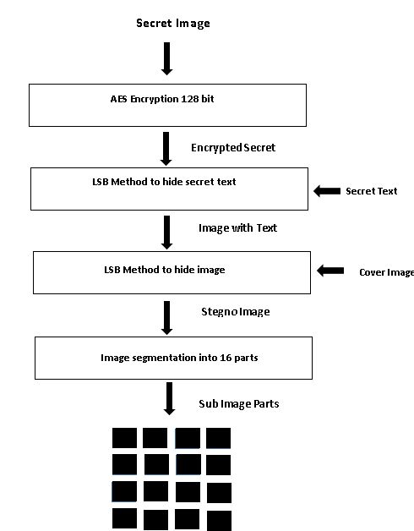
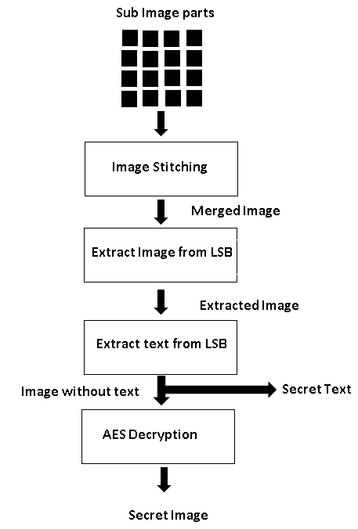
IMPLEMENTATION & DESIGN
Sequence of steps performed by sender
Sequence of steps performed by receiver
Bangalore Institute of Technology
Dept. of ECE, BIT

Slide 17
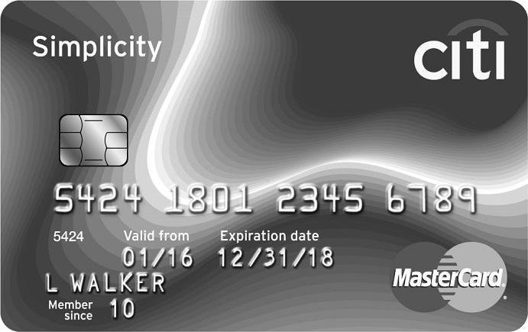

RESULTS & OBSERVATIONS
AES encryption
LSB IMAGE BASED STEGANOGRAPHY
Secret image
Encrypted image
Image with text
Cover Image
Stegno Image
Segmented Image
Bangalore Institute of Technology
Dept. of ECE, BIT

Slide 18
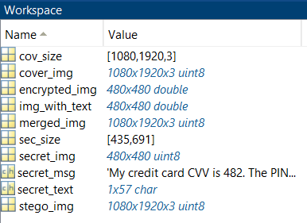
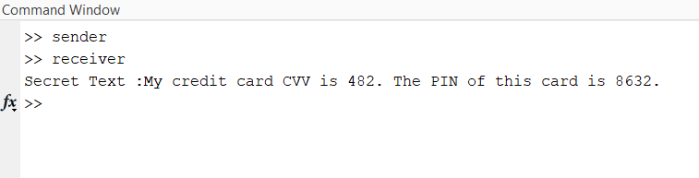
RESULTS & OBSERVATIONS
Merged Image
Extracted Secret image
Decrypted secret image
Command window
Work space window
Bangalore Institute of Technology
Dept. of ECE, BIT

Slide 19
CONCLUSION
By encrypting the secret image the original content is concealed and protected from unauthorized access from which confidentiality is enhanced more.
The use of LSB-based image steganography makes it difficult for potential attackers to detect its existence.
Breaking down the stego image into multiple parts and transmitting them separately enhances security.
By embedding the secret image and message within the cover image using LSB-based steganography, provides an added layer of protection against data interception.
The proposed technique offers practical applicability in industries dealing with confidential data, such as defense, finance, or research, can benefit from this approach to protect sensitive images and messages.
Bangalore Institute of Technology
Dept. of ECE, BIT

Slide 20
FUTURE WORK
Robustness Analysis: Conduct a comprehensive analysis of the proposed technique's robustness against various attacks and potential vulnerabilities.
Optimal Image Fragmentation: Investigate and develop algorithms to optimize the fragmentation of the stego image for transmission.
Network Security Integration: Integrate the proposed technique with existing network security measures, such as secure transmission protocols (e.g., SSL/TLS) or intrusion detection systems (IDS).
Usability and User Interface Enhancements: Pay attention to the usability aspects of the system by improving the user interface and overall user experience.
Bangalore Institute of Technology
Dept. of ECE, BIT

Slide 21
REFERENCES
[1] “128-bit AES Implementation for Secured Wireless Communication” Gohil Rikitaben Karsanbhai and Mary Grace Shajan of Electronics and Communication Department, Parul Institute of Engineering and Technology, Vadodara, India.
[2] “Hiding data in images using steganography techniques with compression algorithms”, Osama F. Abdel Wahab, Aziza I. Hussein, Hesham F. A. Hamed, Hamdy M. Kelash, Ashraf A.M. Khalaf and Hanafy M. Ali, Faculty of Engineering, Minia University, El Minia, Egypt2Electrical & Computer Eng. Dept., Effat University, Jeddah, KSA4Faculty of Electronic Engineering, Menoufia University, Menouf, Egypt
Bangalore Institute of Technology
Dept. of ECE, BIT

